Slide 1

Practice
Wenxuan Shi
College of Software, Nankai University
Email: shiwx@nankai.edu.cn
Wechat: 13920561100

Slide 2
Topics
Samples
Cookbook
Web Demos

Slide 3
Samples https://github.com/flutter/samples https://flutter.github.io/samples/#
Notes:
StatelessWidget is used for immutable elements that only rely on the object configuration information
StatefulWidget is used for elements that can dynamically change based on state-changes in the system
Everytime that state changes, setChange() is called by the object

Slide 4
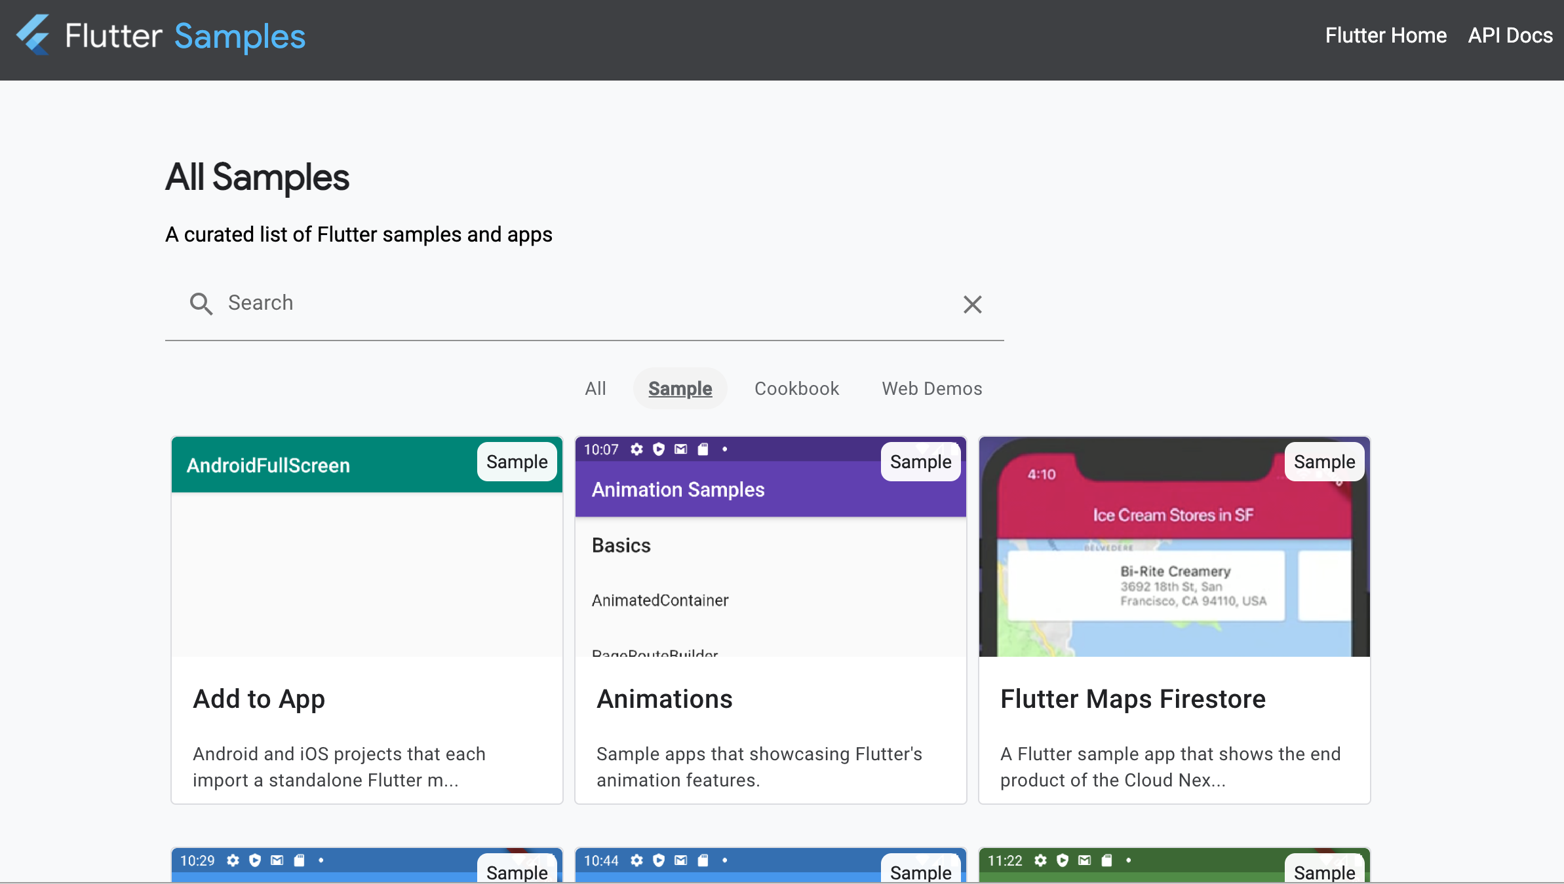

Slide 5
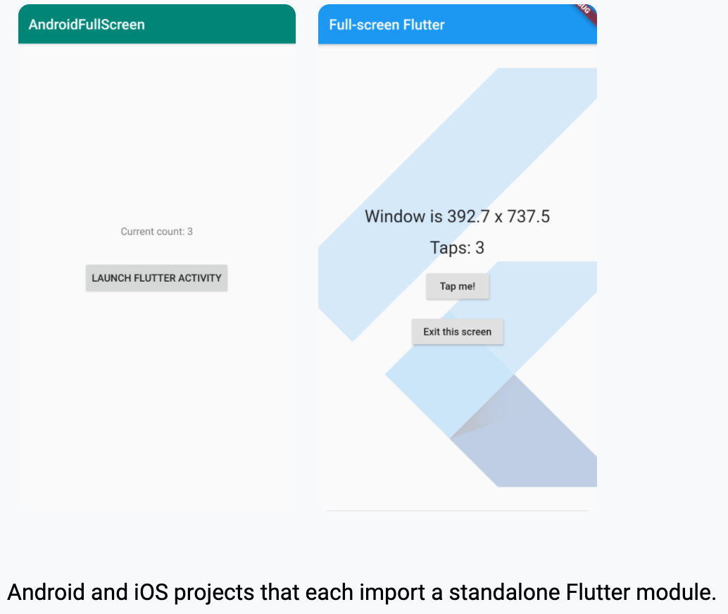
Add to App
This directory contains a bunch of Android and iOS projects that each import a standalone Flutter module.

Slide 6
Goals for this sample
Show developers how to add Flutter to their existing applications.
Show the following options:
Whether to build the Flutter module from source each time the app builds or rely on a separately pre-built module.
Whether plugins are needed by the Flutter module used in the app.

Slide 7
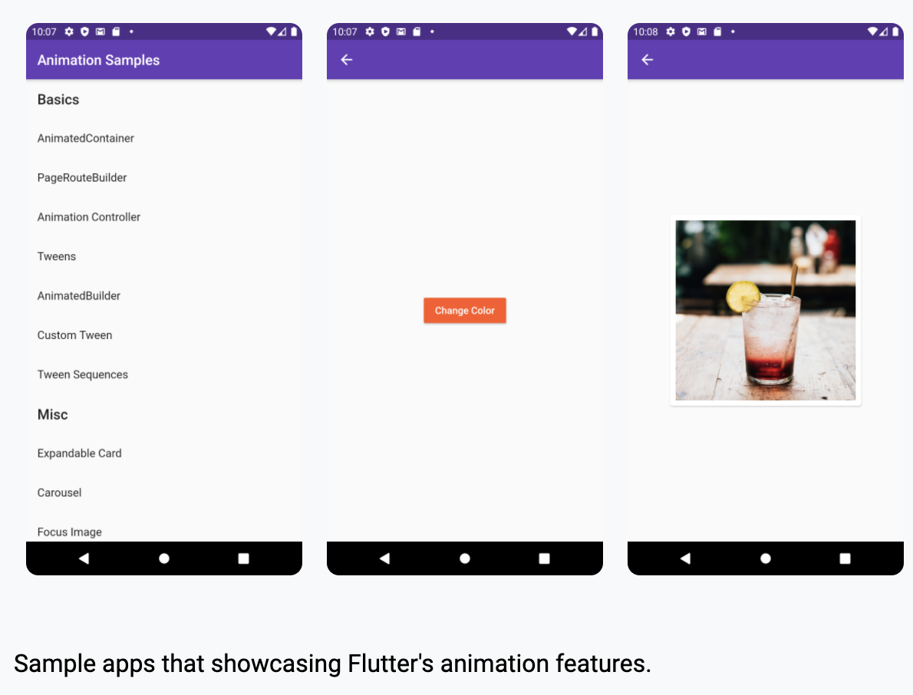
Animations
Sample apps that showcasing Flutter's animation features

Slide 8
Goals
Demonstrate the building blocks for animations and how they work together
Provide samples for common patterns and use-cases

Slide 9
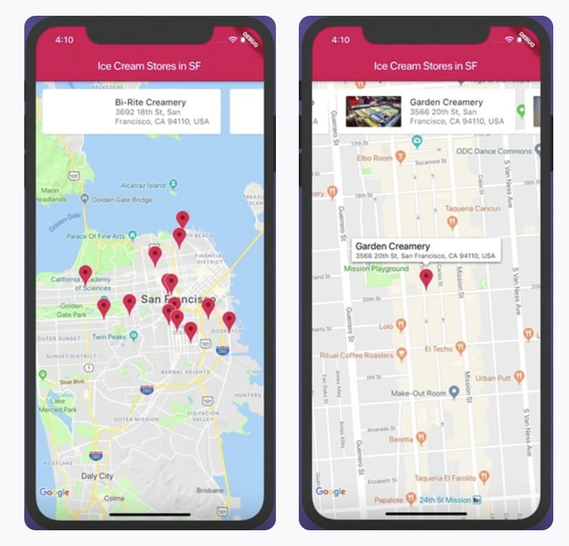
Flutter Maps Firestore
A Flutter sample app that shows the end product of the Cloud Next '19 talk Build Mobile Apps With Flutter and Google Maps. The live coding starts at about 17:40.

Slide 10
Goals for this sample
Showcase how to build an app that uses Google Maps with Flutter:
Loading a list of Ice Cream shops from Cloud Firestore
Listing the shops in a custom carousel
Showing the shop locations on a map using Markers
Controlling the Google Map from the carousel

Slide 11
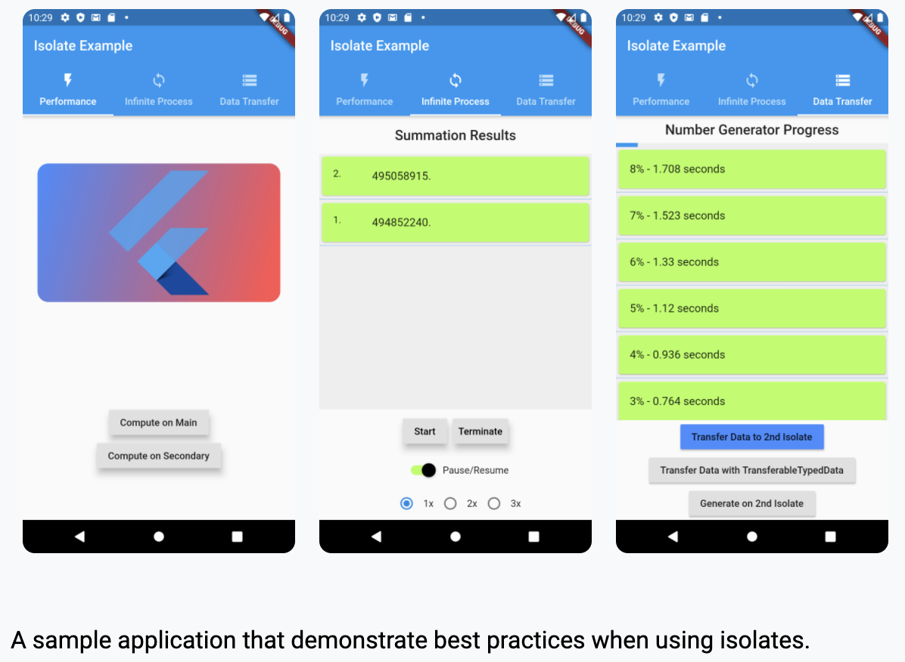
Isolate Example
A sample application that demonstrate best practices when using isolates.

Slide 12
Goals
Display the performance benefits of isolates when using them in the right situation.
Show how to use the compute method for straightforward computations.
Demonstrate how to initialize and use an isolate.
Show the cost of moving data between isolates and provide alternatives.

Slide 13
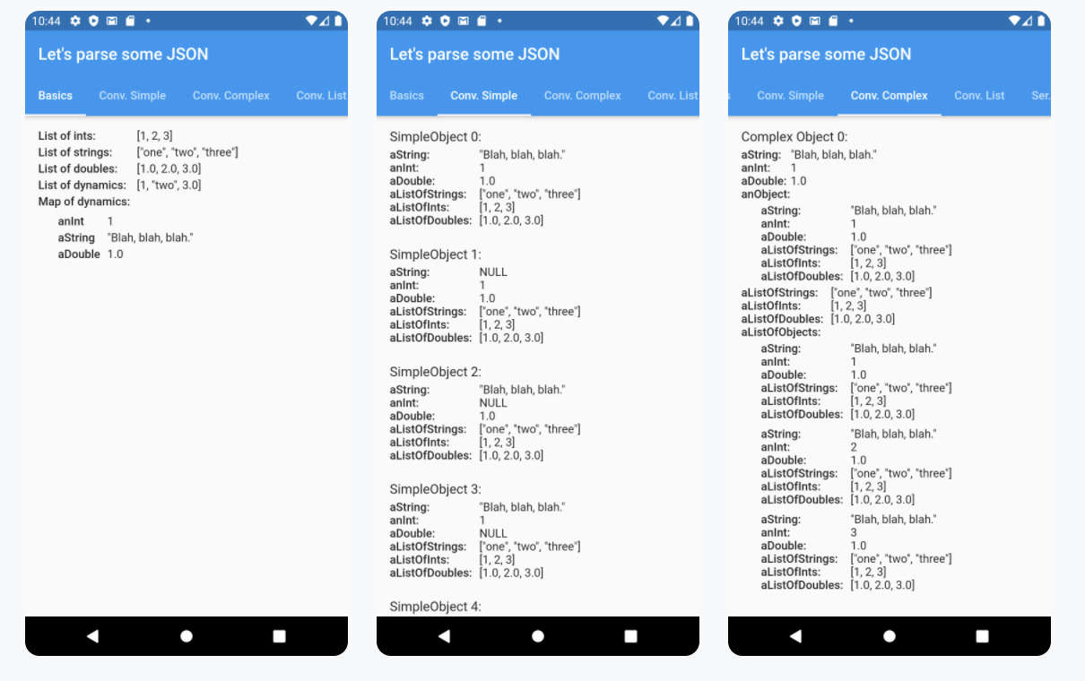
jsonexample
A Flutter sample app that deserializes a set of JSON strings using three different libraries: dart:convert, json_serializable, and built_value.

Slide 14
Goals for this sample
Help you decide which of the three most common libraries for deserializing JSON is right for your project.
Provide you with example code for deserializing:
Simple and nested objects
Lists of primitive values
Maps containing primitive values

Slide 15
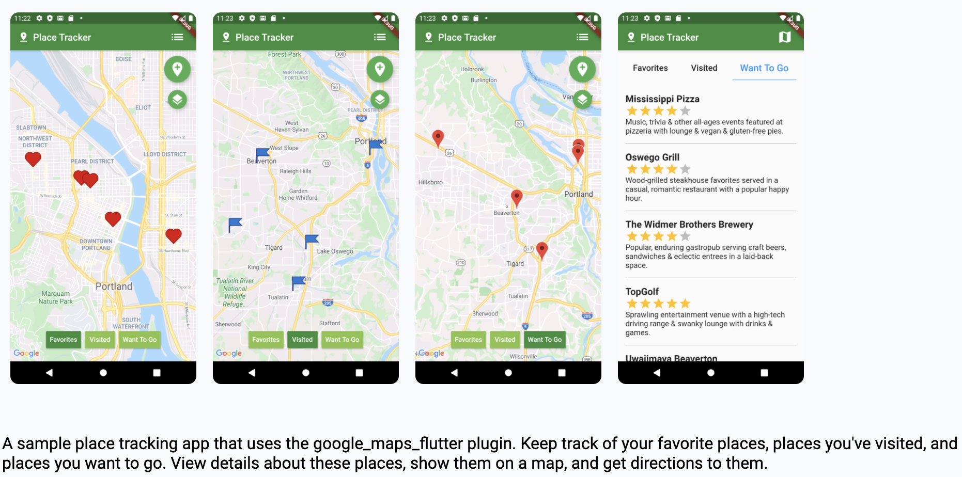
Place Tracker
A sample place tracking app that uses the google_maps_flutter plugin.

Slide 16
Goals
Learn how to create an interface composed of GoogleMap and other widgets.
Learn how to show, control, and modify a GoogleMap widget.
Learn how to place a marker on a map.

Slide 17
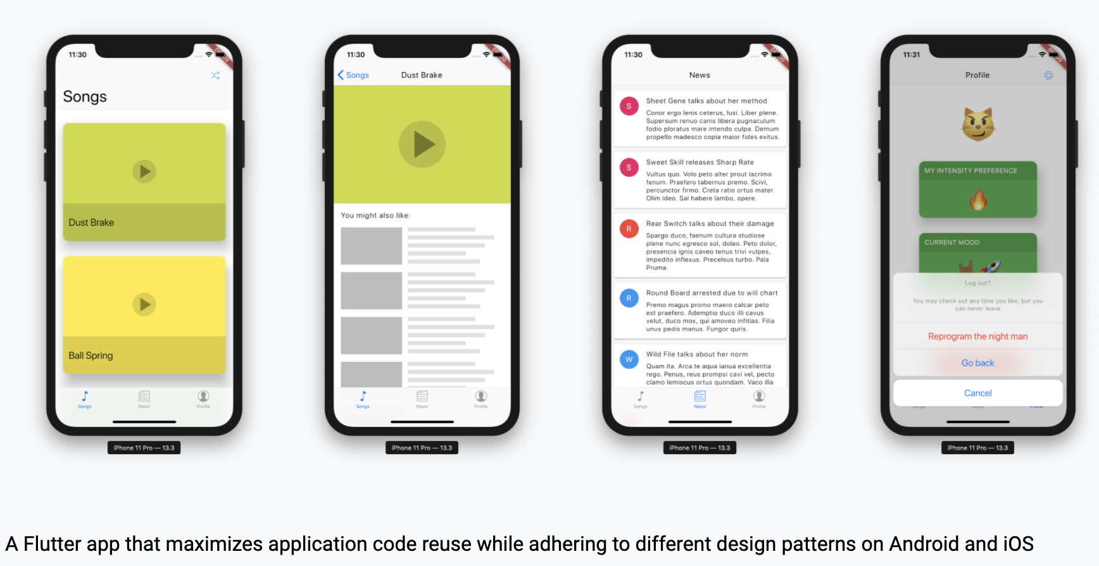
Platform Design
This sample project shows a Flutter app that maximizes application code reuse while adhering to different design patterns on Android and iOS.

Slide 18
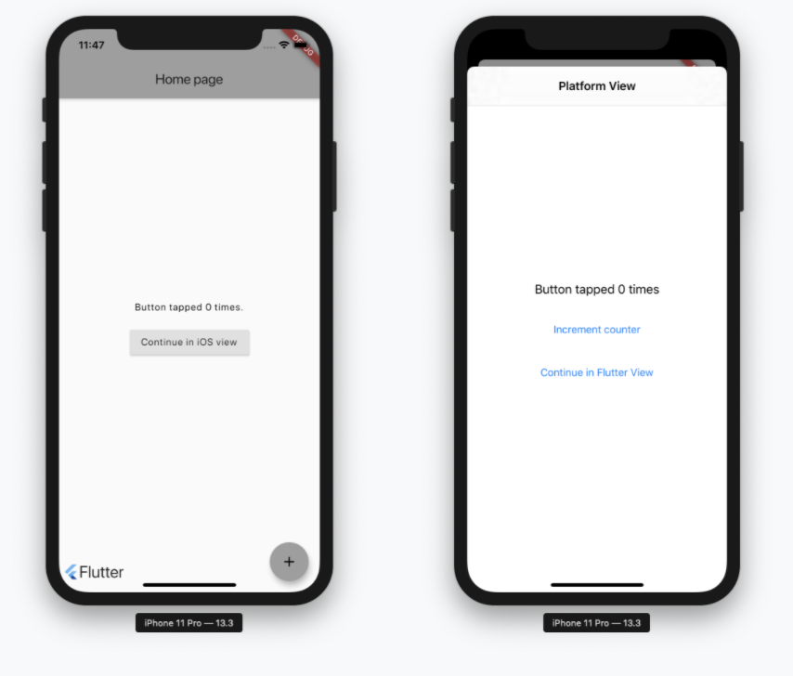
Platform View Swift
A Flutter sample app that combines a native iOS UIViewController with a full-screen Flutter view.
Goals for this sample
Show a simple technique for combining native and Flutter views.

Slide 19
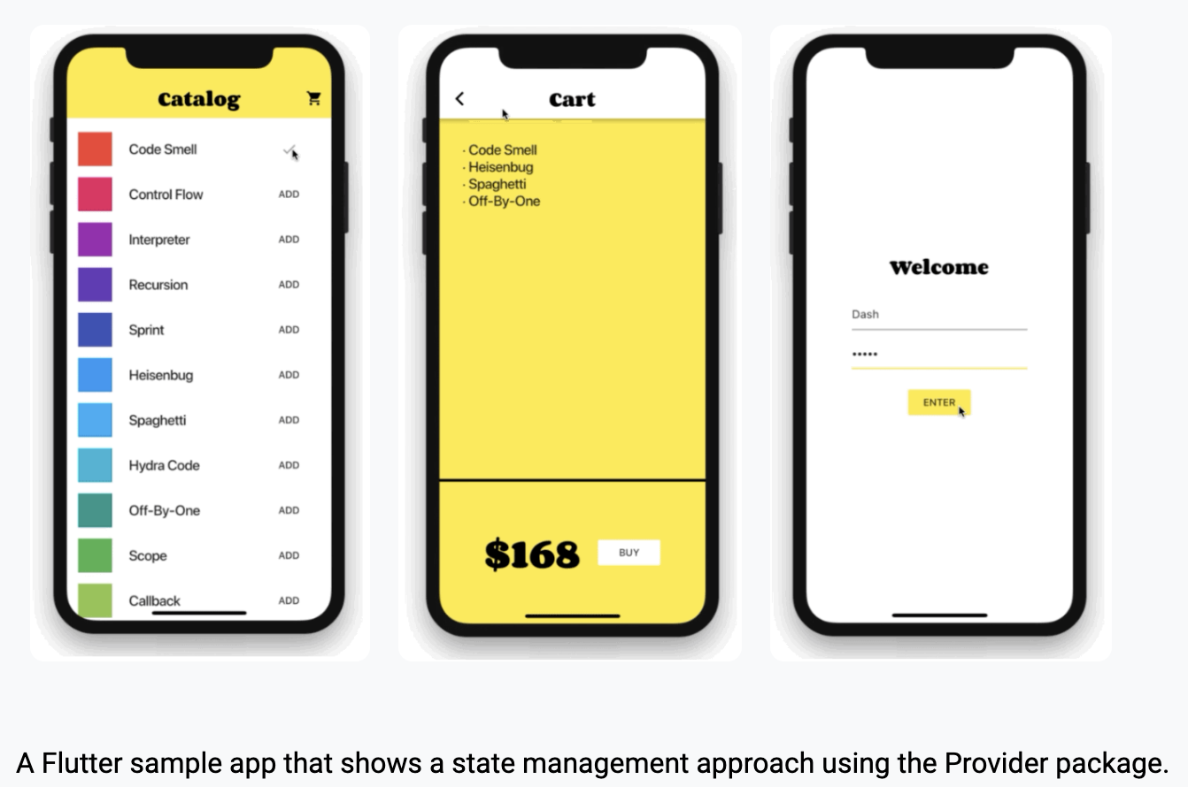
Provider Shopper
A Flutter sample app that shows a state management approach using the Provider package.

Slide 20
Goals for this sample
Show simple use of Provider for providing an immutable value to a subtree
Illustrate a simple state management approach using the ChangeNotifier class
Show use of ProxyProvider for provided objects that depend on other provided objects

Slide 21
Cookbook
Notes:
StatelessWidget is used for immutable elements that only rely on the object configuration information
StatefulWidget is used for elements that can dynamically change based on state-changes in the system
Everytime that state changes, setChange() is called by the object

Slide 22
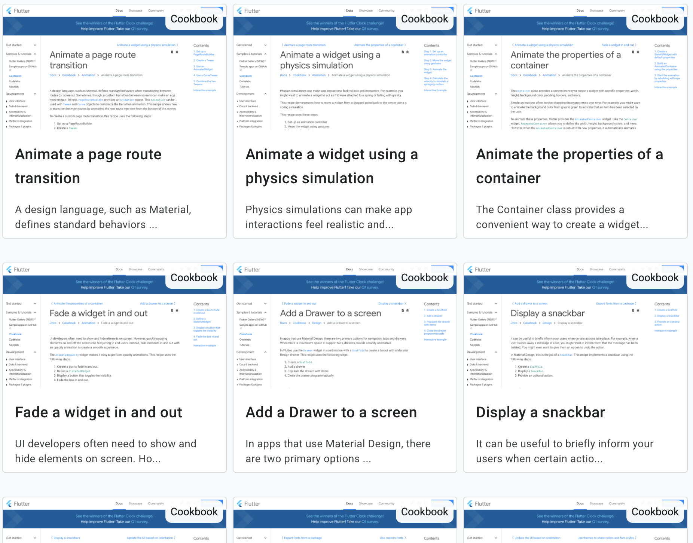
Introduction
Docs: https://flutter.dev/docs/cookbook
Source Code: https://flutter.github.io/samples/#?type=cookbook

Slide 23
Web Demos
Notes:
StatelessWidget is used for immutable elements that only rely on the object configuration information
StatefulWidget is used for elements that can dynamically change based on state-changes in the system
Everytime that state changes, setChange() is called by the object

Slide 24
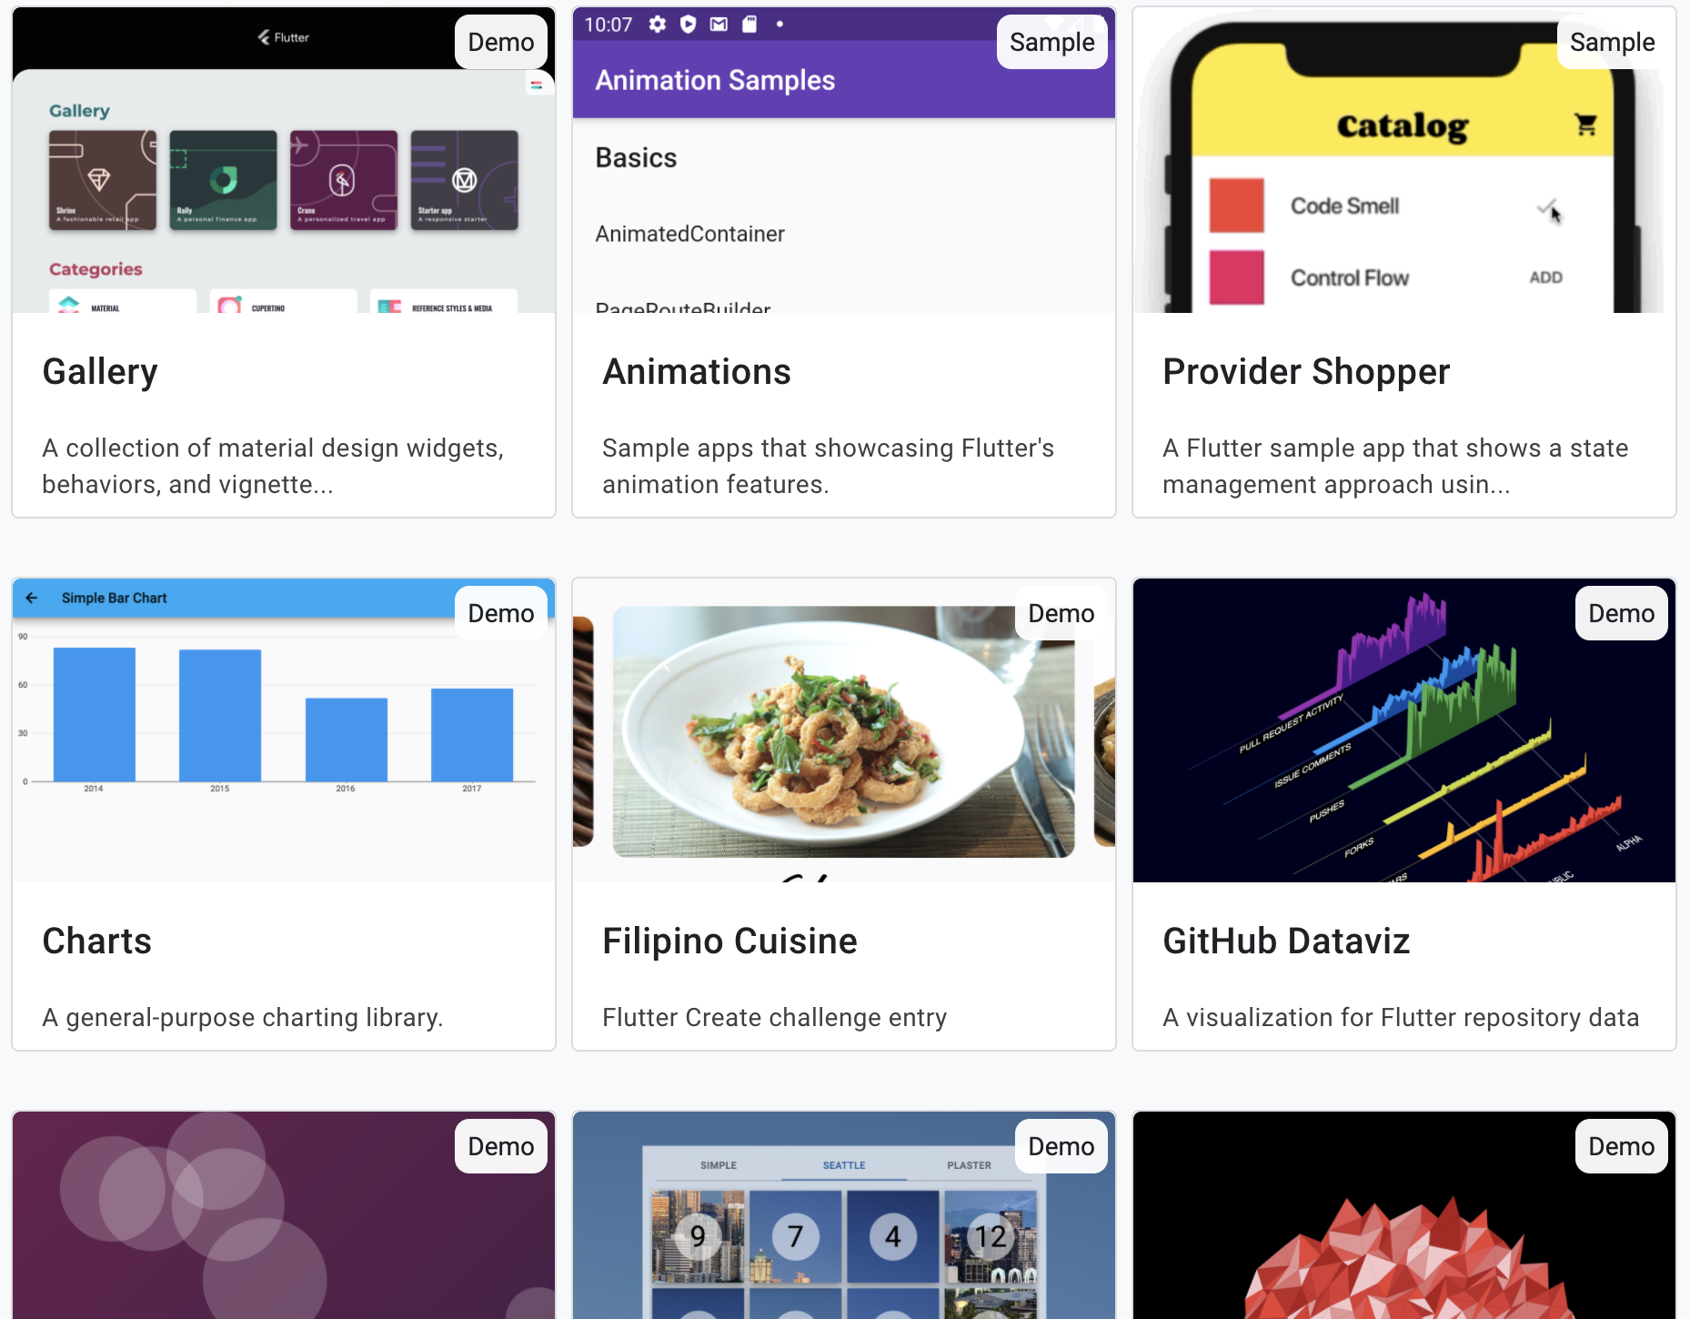
Introduction
Demos: https://flutter.github.io/samples/#?platform=web
Source Code: https://github.com/flutter/samples/tree/master/web

Slide 25
Thank you!
Wenxuan Shi
College of Software, Nankai University
Email: shiwx@nankai.edu.cn
Wechat: 13920561100

